Slide 1
.NET
Session 4

Slide 2
Overview
Recap last session
Databases & History of Databases
ORM (Object-Relation Mapping)
EF Core (Entity Framework Core)

Slide 3
Last Session
User Management Project
CRUD Coding Session

Slide 4
Databases
A database is an organized collection of structured information, or data, typically stored electronically in a computer system
Structured data
Semi-Structured data
Unstructured data
Common database types nowdays
Relational Databases
NoSQL Databases

Slide 5
Relation Databases
Stores data in tables linked by predefined relationships, highly structured
Common examples include SQL Server, MySQL, PostgreSQL, and Oracle
Ideal for applications requiring complex queries and transaction consistency
OLTP (Online Transaction Processing)
OLAP (Online Analytical Processing)

Slide 6
NoSQL Databases
Designed for flexibility with unstructured and semi-structured data
Document Stores
MongoDB
Key-Value Stores
Redis
Graph Databases
Neo4j
Wide-Column Stores
Cassandra
Scylla DB

Slide 7
Database Core Concept
Tables
Rows
Columns
Relationships Between Tables
Normalization (1NF, 2NF, 3NF)
SQL
SQL Commands (DDL, DML, DCL, TCL, DQL)

Slide 8
Database Relationships
One-to-One
Each row in one database table is linked to 1 and only 1 other row in another table
One-to-Many
A row in one table can be related to many rows in another table
Many-to-Many
Rows in one table can be related to many rows in another table, and vice versa
A foreign key is a field (or collection of fields) in one table that uniquely identifies a row of another table or the same table. It is used to establish and enforce a link between the data in two tables

Slide 9
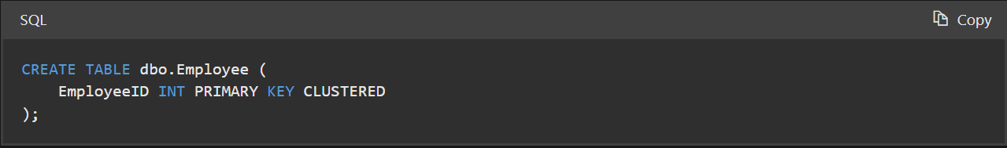
DDL (Data Definition Language)
DDL commands are used to define, alter, and manage the structure of database objects like tables, schemas, and databases
Commands
CREATE
ALTER
DROP
TRUNCATE

Slide 10
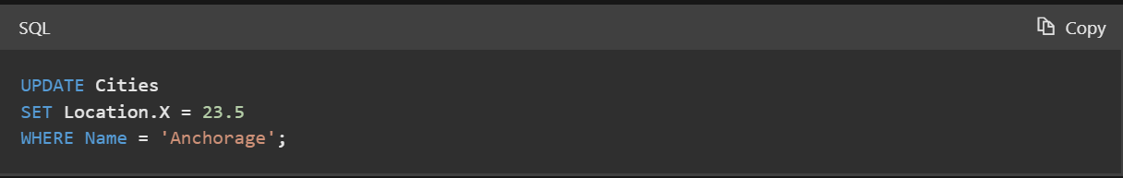
DML (Data Manipulation Language)
DML commands are used to retrieve, store, modify, delete, insert and update data in a database
Commands
SELECT (SELECT INTO …)
INSERT
UPDATE
DELETE

Slide 11
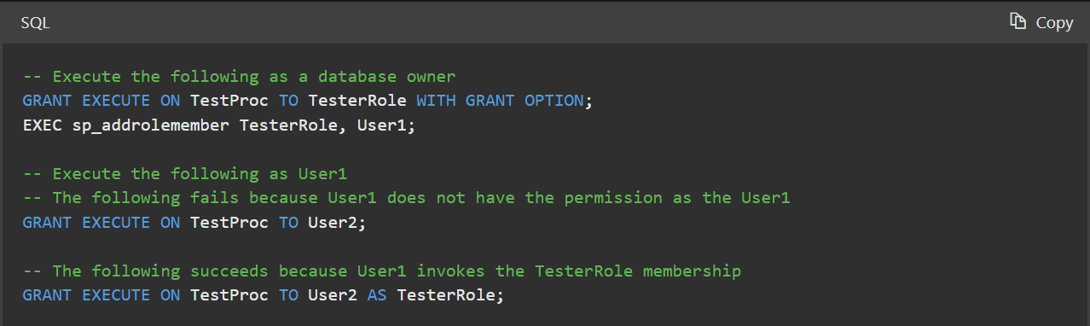
DCL (Data Control Language)
DCL commands are used to control access to data in the database. They are crucial for enforcing database security
Commands
GRANT
REVOKE

Slide 12
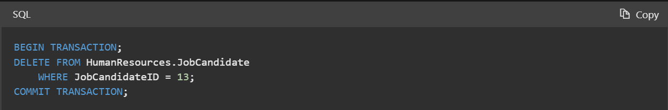
TCL (Transaction Control Language)
TCL commands manage the changes made by DML statements. They are used to handle transaction processing
Commands
COMMIT
ROLLBACK
SAVEPOINT

Slide 13
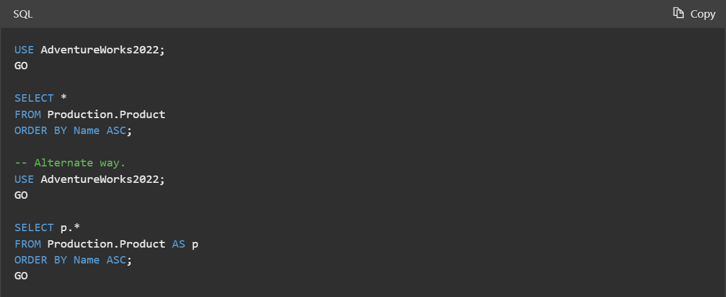
DQL (Data Query Language)
DQL is specifically used for querying data and includes only one command
Commands
SELECT

Slide 14
ORM
ORM – Object Relation Mapping
ORM is a technique that lets developers query and manipulate data from a database using an object-oriented paradigm
It acts as a virtual object database that can be used from within a programming language
Simplifies database interactions by allowing developers to work with data as objects, avoiding the need to write complex SQL queries

Slide 15
ORM
Provides API for
DDL
DML
DQL
TCL

Slide 16
EF Core
What is EF Core & Why
EF Core Concepts
Code First vs Database First
Querying Data with EF Core
How to update data
Migrations
Advanced features of EF Core

Slide 17
What is EF Core
ORM for .NET
Facilitates data access by enabling developers to work with a database using .NET objects, eliminating the need for most of the data-access code they usually need to write

Slide 18
History of EF Core
First released in 2008 with .NET Framework 3.5
Entity Framework 4.0 to 6.0
Windows Only
EF 4.0 (2010): Introduction of features like POCO support, lazy loading, and model-first development
EF 5.0 (2012): Performance improvements, introduced enums, spatial data types, and table-valued functions

Slide 19
History of EF Core
EF 6.0 (2013): Open-sourced on GitHub, added asynchronous query and save capabilities, customizable conventions, and code-based configuration
Recognizing the need for a more modern, modular, and cross-platform framework, Microsoft introduced Entity Framework Core (EF Core) in 2016 alongside .NET Core

Slide 20
Why EF Core
One of the best and most complete ORM
Integrated with LINQ
Designed to be lightweight, extensible, and able to support both traditional RDBMS and newer NoSQL databases
Backed by Microsoft

Slide 21
EF Core Concepts
Configuration
DbContext & DbSet
Relationships
Change Tracking
Migrations
Code First vs Database First

Slide 22


EF Core Configuration
Microsoft.EntityFrameworkCore
Microsoft.EntityFrameworkCore.SqlServer
Microsoft.EntityFrameworkCore.Design
Used for Migrations

Slide 23
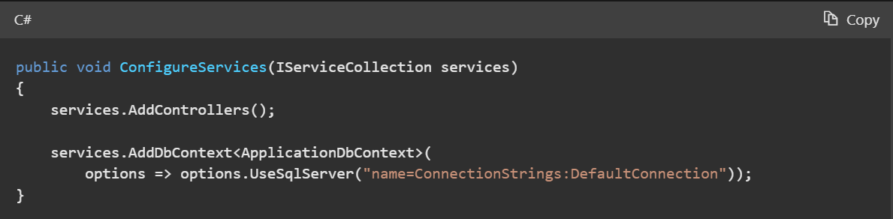
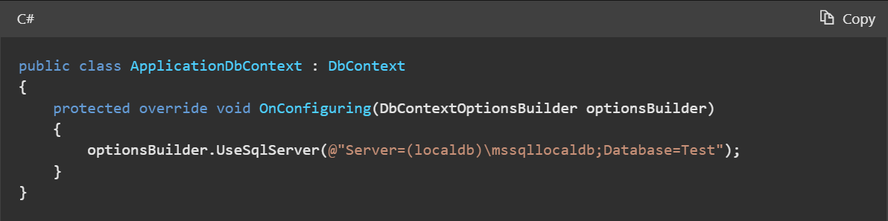
EF Core Configuration
Overriding OnConfiguring inside DbContext
In Program.cs using dependency injection

Slide 24
DBContext & DbSet
Represent database and tables in database
DbContext represents a session with the database and can be used to query and save instances of your entities. It is a combination of the Unit Of Work and Repository patterns
Automatically keeps track of changes to instances of your entities, which can be submitted to the database
DbSet represents a collection of entities of a specific type that you can query or save (Table)
Simplifies performing create, read, update, and delete operations

Slide 25
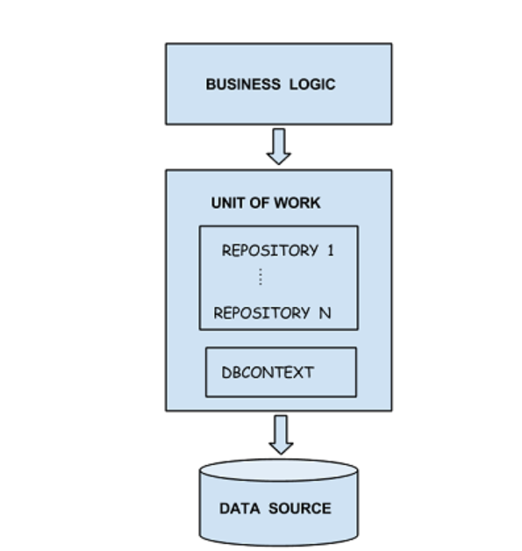

Slide 26
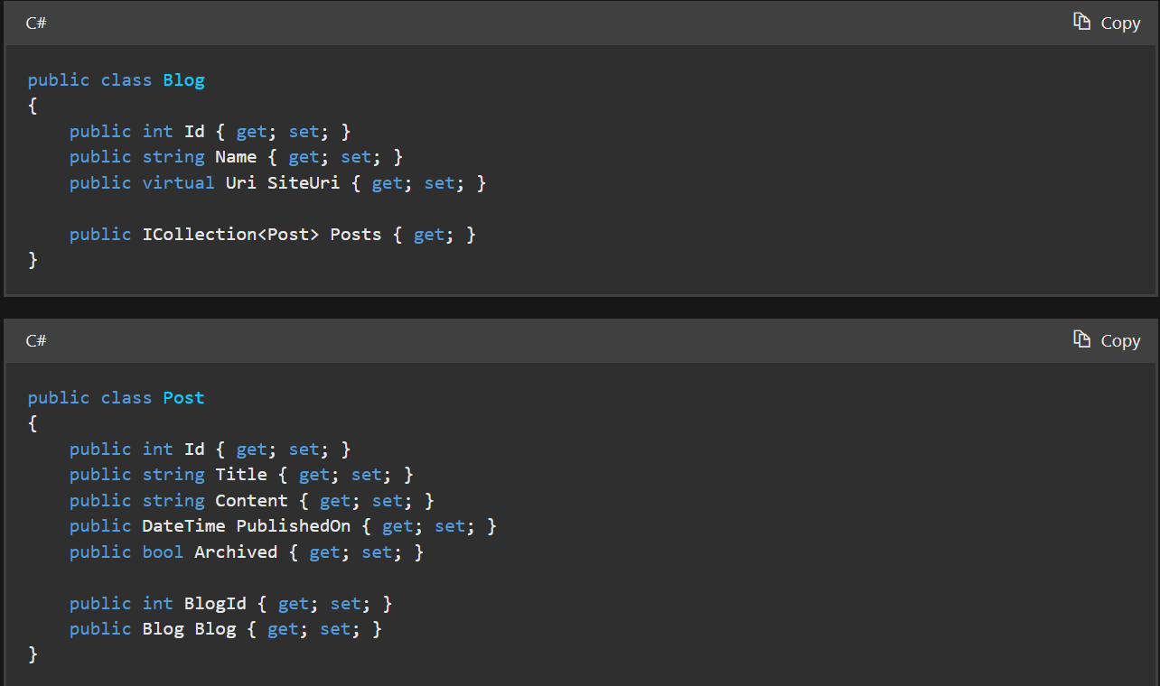
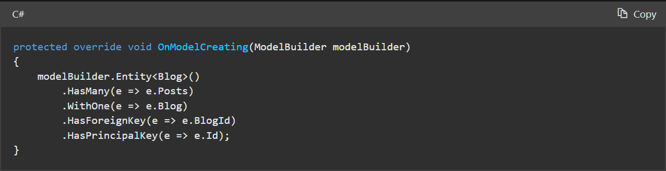
Relationships

Slide 27
Change Tracking
A component of EF Core that keeps track of changes made to entities during the context's lifetime
Manages state information for each entity retrieved from or tracked by the DbContext
Content:
Unchanged: Entity has not been modified since it was retrieved.
Modified: Some or all of an entity's property values have been modified.
Added: Entity is newly created and needs to be inserted into the database.
Deleted: Entity has been marked for deletion.
Detached: Entity is not being tracked by the context.

Slide 28
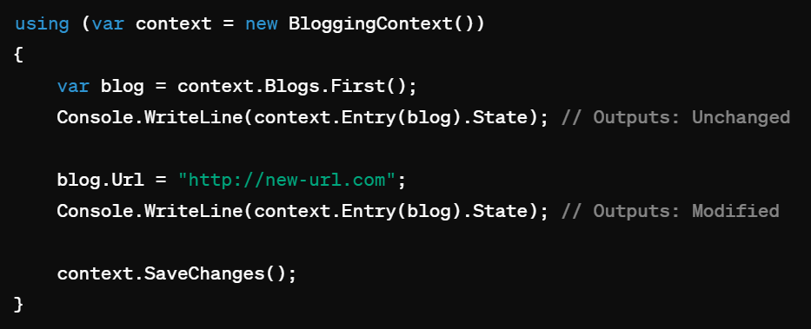
Change Tracking
AsNoTracking

Slide 29
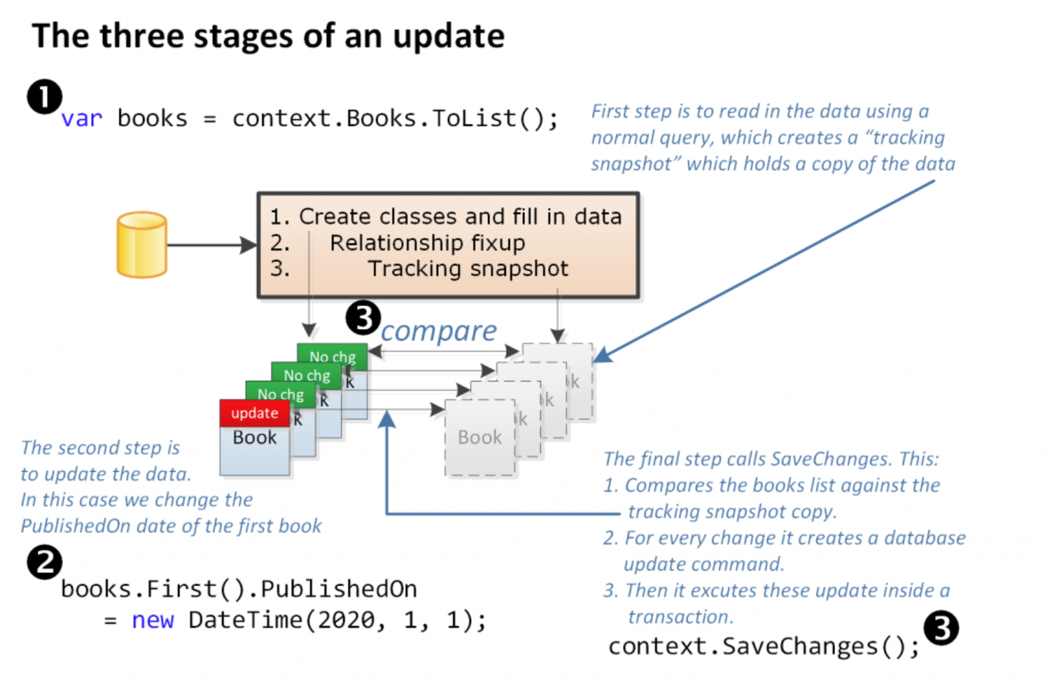

Slide 30
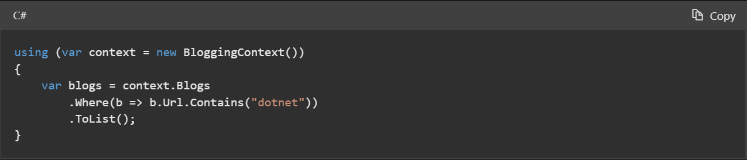
Querying Data with EF Core
Using LINQ
Where
Include
ThenInclude
Deferred execution
ToList/ToListAsync
First/FirstAsync
FirstOrDefault/FirstOrDefaultAsync
Single/SingleAsync
SingleOrDefault/SingleOrDefaultAsync
…

Slide 31
Insert & Update Data with EF Core
Using Add & Update methods
Data will not be persisted until SaveChanges/SaveChangesAsync is omitted

Slide 32
Migrations
Code First Approach
They provide a way to incrementally apply changes to the database schema in a structured and reversible manner
Simplify the process of managing database schema changes, especially in collaborative development environments
Automate the generation of SQL scripts for schema modifications, reducing the risk of manual errors
Generates migration files containing the necessary SQL commands to apply or revert the changes

Slide 33
Migrations
Creating Migrations
dotnet ef migrations add <MigrationName>
Add-migration <MigrationName> (Visual Studio)
Applying Migrations
dotnet ef database update
Update-database (Visual Studio)
Rolling Back Migrations
dotnet ef migrations remove
Remove-Migration (Visual Studio)

Slide 34
Database First
Less used compared to the code first
Manually update database and then scaffold entities into ASP.NET Core project

Slide 35
Advanced features of EF Core
Interceptors
Logging
Spatial data
Table splitting
Complex & Owned Types
Concurrency

Slide 36
QA

Slide 37
Thank you

